Slide 1

Airbnb Demand & Availability -Amsterdam
Course: SCH-MGMT 661 Team: Group 6 Date: May 6, 2025

Slide 2

Executive Summary – Project Overview
🔍 Objective Predict daily bookings for Amsterdam Airbnb listings by merging listing and calendar data.
🧩 Data Used
Listings: 10,000+ entries with host, room, and pricing details
Calendar: Daily price and availability (~2 million records)
Merged datasets for temporal + spatial insights
🤖 Final Model
Random Forest Classifier
Outperformed logistic and gradient boosting models
Chosen for handling high-dimensional, non-linear data

Slide 3

Executive Summary – Results & Key Insights
📉 Performance Metrics
Accuracy: 90%
F1 Score: 94%
ROC AUC: 95%
📌 Key Findings
Seasonality: Peaks in April & December; dips in August
Location: Centrum listings most booked
Room Type: Entire homes favored
Pricing: Mid-range pricing sees higher booking rates
💼 Impact
Hosts: Optimize pricing and availability
Airbnb: Enhance tools for hosts and forecast demand
Travelers: Identify ideal booking periods

Slide 4
Problem Statement
Main Question
Can we predict whether an Airbnb listing in Amsterdam will be booked on a specific day?
Stakeholder | Benefit
🏠 Hosts | Optimize pricing strategies, adjust availability, improve occupancy
✈️ Travelers | Identify affordable periods, plan better trips
🏢 Airbnb (Platform) | Understand booking trends, develop host tools, forecast city-wide demand
Business Context
Amsterdam has dynamic tourist seasons, making demand forecasting critical.
Accurate predictions can lead to better revenue management and customer satisfaction.

Slide 5

Datasets Overview
1. Listings Dataset
Entries: 10,075 unique listings
Key features: room_type, neighbourhood, price, host_id, number_of_reviews, minimum_nights, etc.
Type: Static (does not change daily)
2. Calendar Dataset
Size: ~2 million records (daily data for each listing)
Key features: date, available, price
Type: Dynamic (captures daily availability and pricing)
Combined Use
Merged listings and calendar data to create a dataset with both static and time-based features
Enabled richer analysis of how factors like location, room type, and date influence booking likelihood

Slide 6
Data Exploration – Key Insights
Price Distribution
Prices are right-skewed, with the majority under €300.
Values capped at €500 to reduce outlier impact.
Location & Neighborhood
Highest bookings in Centrum – booking rate correlation 0.82.
Noord also shows strong activity – correlation 0.65.
Seasonality Trends
Booking peaks in April and December.
Noticeable dip in August, indicating seasonal variation in demand.

Slide 7
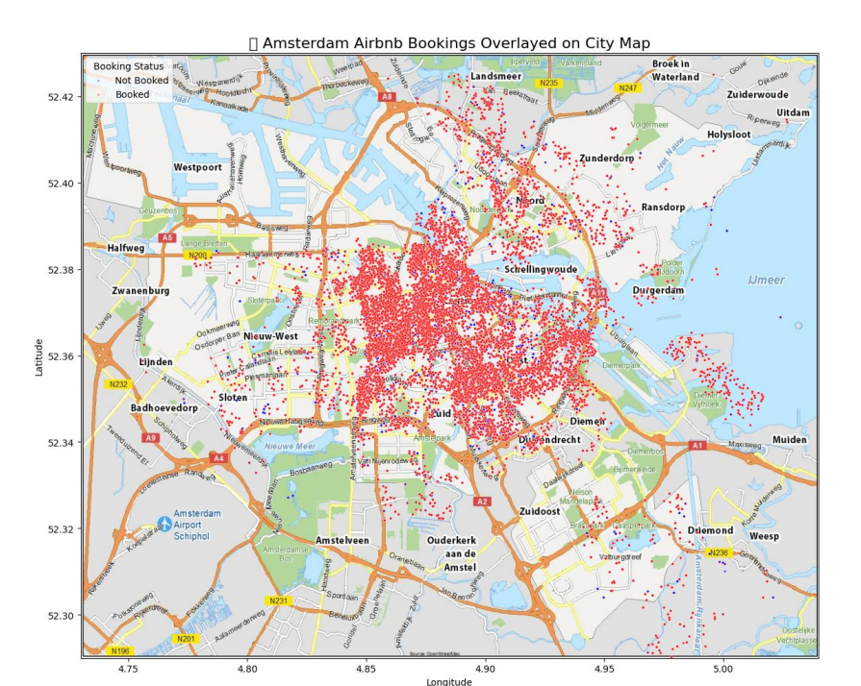
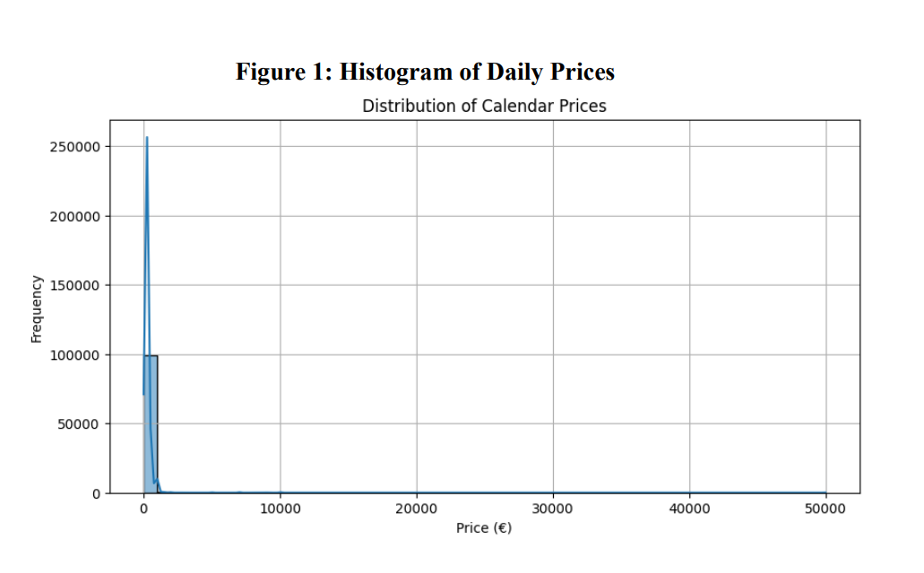
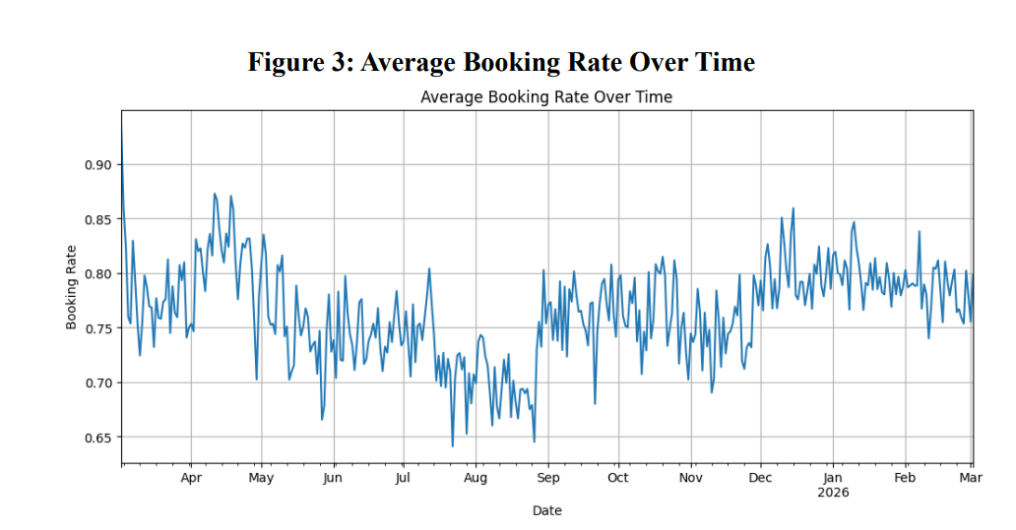
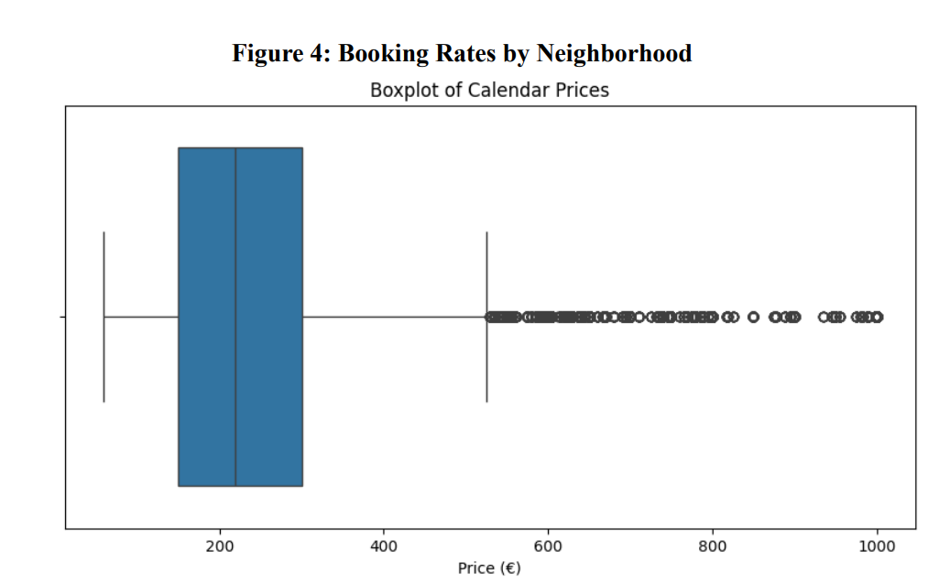

Slide 8

Data Preprocessing
Missing Values
Addressed 21.3% missing entries in listing prices through appropriate imputation.
Data Cleanup
Removed redundant and empty columns to streamline dataset.
Converted price column to numeric format for analysis.
Outlier Handling
Applied capping to extreme values in price and minimum nights to reduce skewness and improve model performance.

Slide 9
Feature Engineering
New Feature Creation
is_booked derived from availability indicator
Temporal features extracted: month, weekday, and holiday
Spatial Insight
Calculated distance_to_center using latitude and longitude
Data Transformation
One-hot encoded categorical variables
Log-transformed price to reduce right skewness and stabilize variance

Slide 10

Model Selection
Multiple models evaluated: Logistic Regression
Random Forest Classifier chosen as final model
Delivered highest accuracy and F1-score among tested models
Performed well in capturing non-linear interactions between features
Suitable for handling high-dimensional and mixed-type data from Airbnb listings

Slide 11

Model Training and Evaluation
Data split using 80/20 train-test ratio with stratified sampling to maintain class balance
Hyperparameter tuning performed using GridSearchCV
n_estimators set to 150
max_depth set to 12
Model performance on test set:
Accuracy: 0.90
F1 Score: 0.94
ROC AUC Score: 0.95
The model demonstrated excellent classification performance and generalization ability

Slide 12

Feature Importance
🔍 What Influences Airbnb Booking Predictions Most?
Using a Random Forest Classifier, we identified the top features that most strongly influence whether a listing gets booked:
🏙 Distance to City Center → Listings closer to the center (Dam Square) are significantly more likely to be booked.
📆 Month → Booking probability varies with seasonality. Peaks observed in April and December.
🗺 Neighborhood → Central neighborhoods like Centrum-West and De Pijp boost booking chances.
💶 Price → Moderately priced listings tend to be booked more often, especially in prime areas.

Slide 13
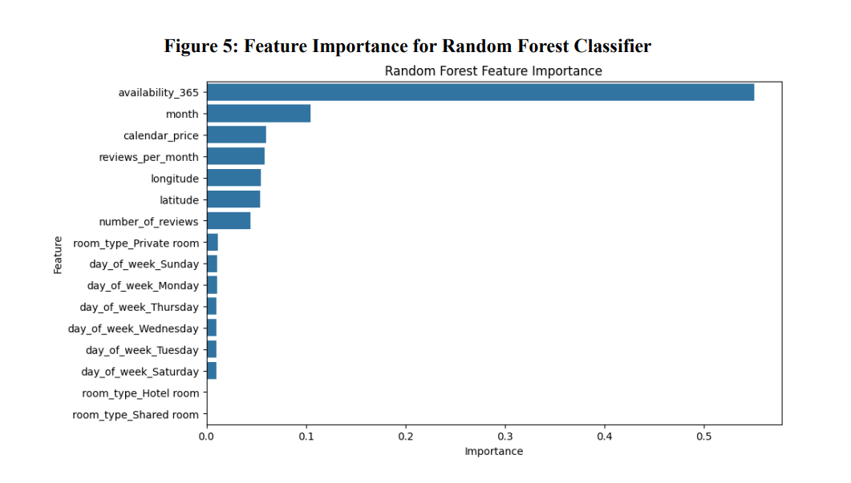
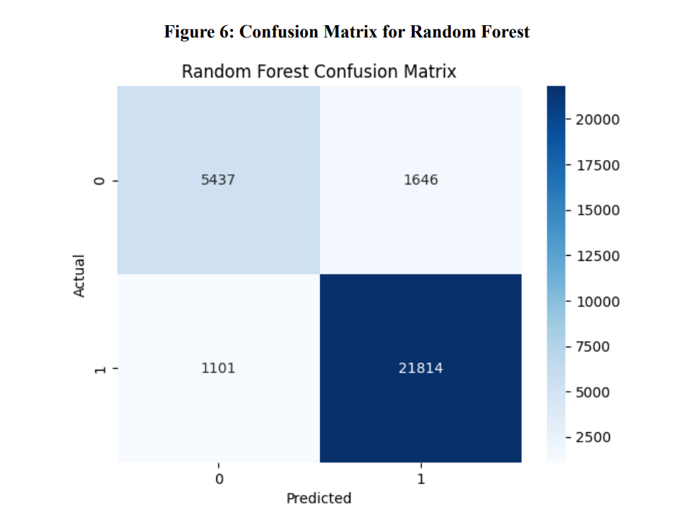

Slide 14

Combining Datasets – Added Value
Why did we merge listings and calendar data?
Model accuracy improved by 6% → Adding calendar data helped the model make better predictions.
Better understanding of time-based patterns → We could track how demand changed by month.
Seasonal insight: → April had 15% more demand than August. → This helps with planning prices and availability.
Key takeaway: Merging the two datasets gave us both better model performance and useful business insights.

Slide 15

Stakeholder Implications
Hosts
Use dynamic pricing based on season and location
Manage availability to match high-demand months
Travelers
Plan trips in the off-season for lower prices
Book early during peak months for better options
Airbnb
Monitor market trends and seasonal demand
Improve host tools (pricing suggestions, availability tips)
Run targeted promotions to balance supply and demand

Slide 16

Recommendations & AI Support
Actionable Recommendations
Adjust prices by ±10–15% based on demand trends
Encourage early bookings during peak seasons (e.g., April)
Offer incentives for listings in low-demand neighborhoods
Build AI-powered dashboards to support host decisions
Generative AI Usage
Used xAI Grok for:
Debugging preprocessing code
Creating initial visualizations
All AI-generated code was manually reviewed for accuracy

Slide 17
Acknowledgments & References
Inside Airbnb dataset for providing detailed listings and calendar data
Scikit-learn library (Pedregosa et al., 2011) for model development
Team contributions in data preprocessing, modeling, analysis, and peer evaluations
References
Pedregosa, F., Varoquaux, G., Gramfort, A., et al. (2011). Scikit-learn: Machine Learning in Python. Journal of Machine Learning Research, 12, 2825–2830.
Inside Airbnb. (2024). Get the data. https://insideairbnb.com/get-the-data/

